Slide 1
Mind Map Generator 2nd edition
Ain Shams University
Faculty of Computer and Information Sciences
Computer Science Department

Slide 2
Supervisors
Prof. Dr. Taymour Nazmy
Dr. Mohamed Abdeen
Assistant
Mohammad Hamdy

Slide 3
Team Members
Fatima Mohammad Abdullah (CS)
Marwa Soliman Mohamed (IS)
May Mahmoud Samy (CS)
Mona Othman Abd El Aziz (CS)
Shahenda Magdy Nasr El Din (IS)

Slide 4

Agenda
Introduction
Previous Work
Problem Definition
Objective
Work Phases
Conclusion
Future Work
Tools
References

Slide 5
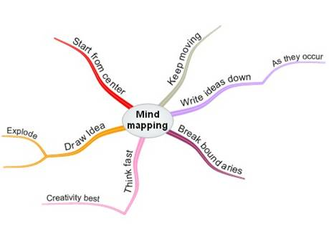
What is a mind map?
A diagram used to represent words, ideas, tasks, or other items linked to and arranged around a central key word or idea.
Notes:
Images and stuff

Slide 6
What is a mind map?
Mind Maps are a way of representing associated thoughts with symbols rather than with unrelated words.
The mind forms associations almost instantaneously, and "mapping" allows you to write your ideas quicker than expressing them using only words or phrases.

Slide 7
What is mind mapping?
It is a creativity- and productivity-enhancing technique that can improve the learning and efficiency of individuals.
Mind mapping uses pictures and/or word phrases to organize and develop thoughts in a non-linear fashion.

Slide 8
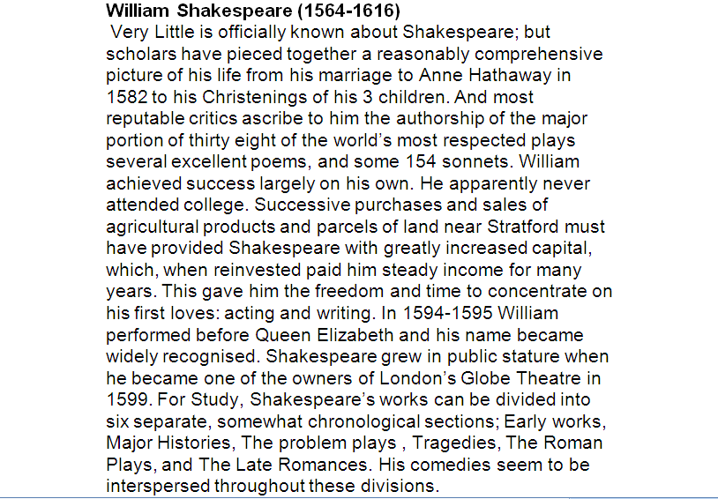
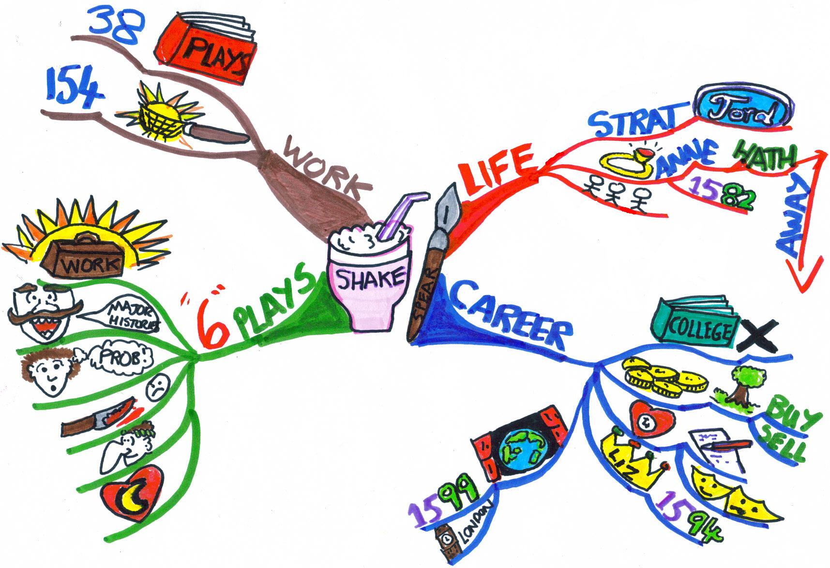
A mind map is created around a single word, placed in the center, to which associated ideas, words and concepts are added branching out.
Notes:
Could use another better looking example

Slide 9
Why use mind maps ?
British popular psychology author Tony Buzan claims to have invented modern mind mapping.
He argues that while 'traditional' outlines force readers to scan left to right and top to bottom, readers actually tend to scan the entire page in a non-linear fashion.
Buzan also uses popular assumptions about the cerebral hemispheres in order to promote the exclusive use of mind mapping over other forms of note making.
Notes:
Could then elaborate on his idea with a diagram or so

Slide 10
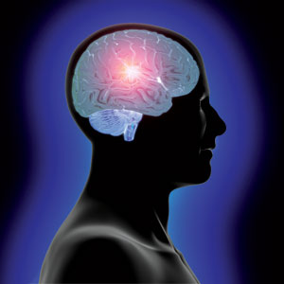
Why use mind maps ? (Cont’d)
Our brain is divided into two hemispheres:
The left hemisphere:
which is responsible for words, calculations, logic , numbers and thinking.
The right hemisphere:
which is responsible for all colors, imagination ,drawing, voice , music and feelings.

Slide 11
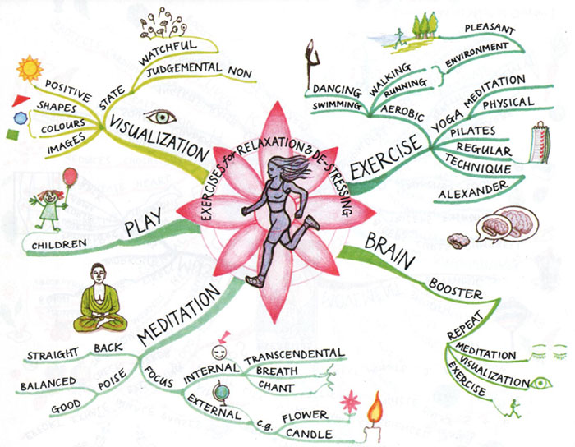
Buzan claims that using mind mapping
allows the best use of both the left and right halves of the brain leading to multiplying the intellectual power

Slide 12

Why use Mind Maps? (cont’d)
To generate, visualize, structure, and classify ideas
As an aid in study, organization, problem solving, decision making, and writing

Slide 14
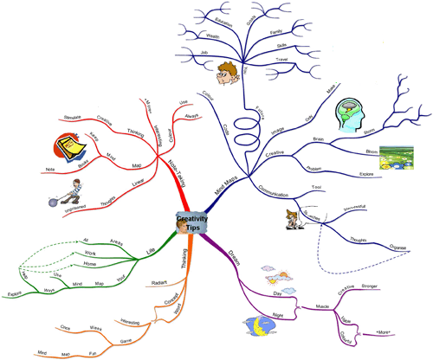
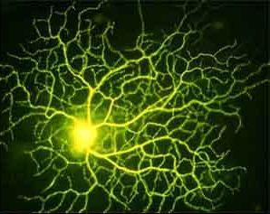

Slide 15
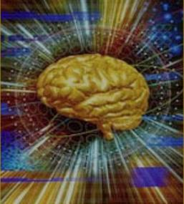
How does our brain work?
It consists of trillion neural cell.
It contains 100 trillion links between neural cells.
So we want to make the best of that
Linear note taking has been limiting our brain's potential, the most important is that it fails to stimulate the brain creatively, the linear presentation of standard notes prevents the brain from making associations.

Slide 16

Creating Mind Maps
Mind maps can be drawn by hand

Slide 17


Slide 18
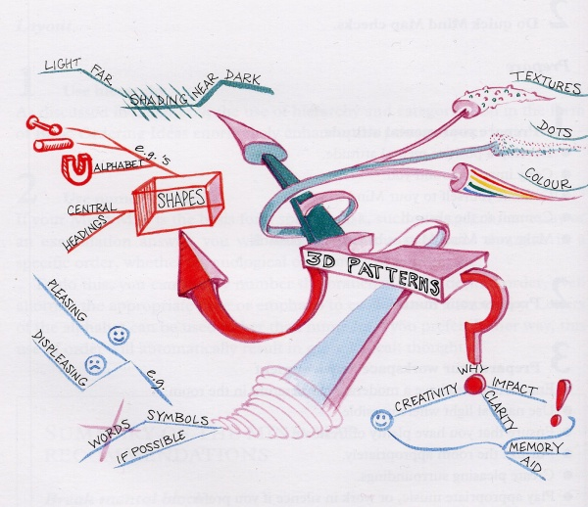

Slide 19


Mind Maps can be drawn using one of the available computer softwares which help the user in drawing the mind map.
Examples of these softwares:
Mind Mapper
Solution Language Tool
Text2MindMap

Slide 20
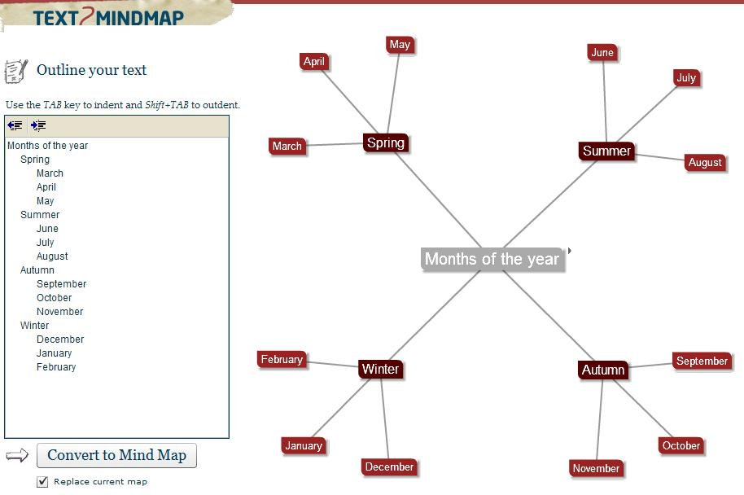

Slide 21
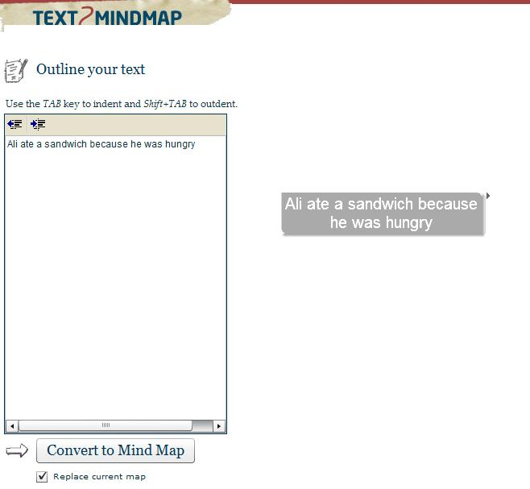

Slide 22
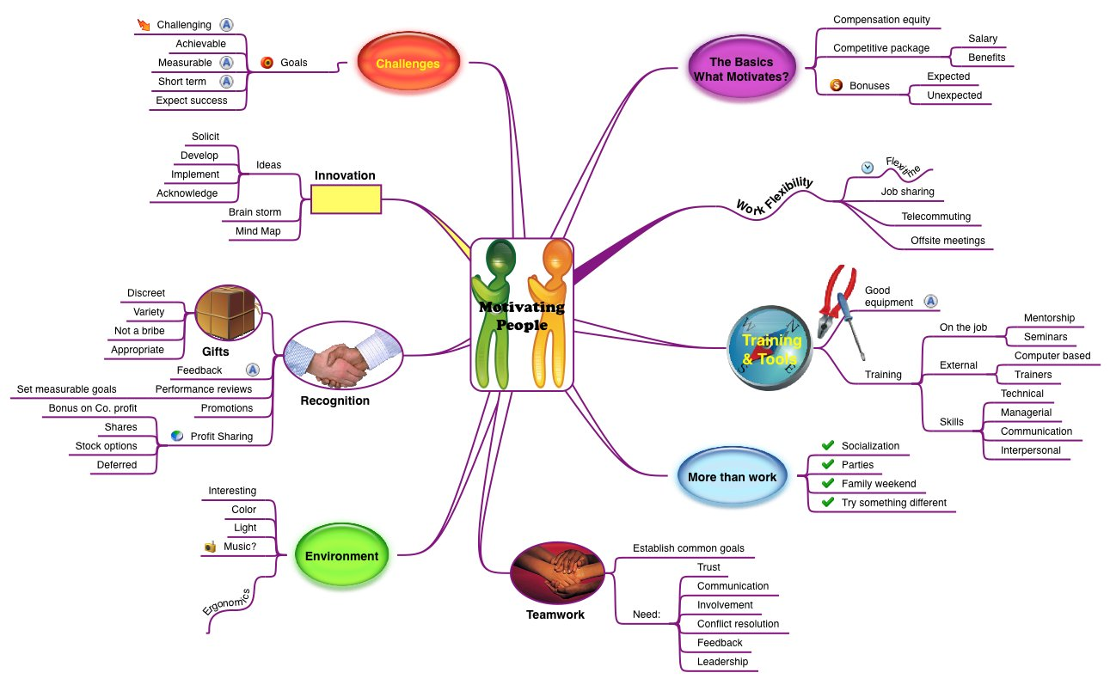

Slide 23
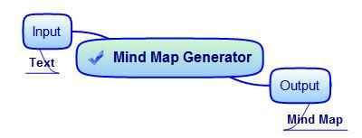
Mind Map Generator 2007/2008

Slide 24
Mind Map Generator 2007/2008 Limitations
It only takes simple text.
Produced a single leveled mind map.
The output was crammed.
Notes:
New Contributions: Accept docs of complex English rules also.

Slide 25
New Contributions
Generate an automatically laid out
multileveled mind map from text of more complex English.

Slide 26
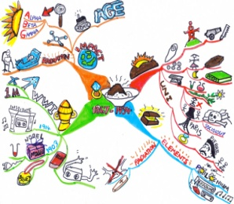
Plain English Text
Frontend
Meaning Representation
Multilevel TMR
Mind Map Conversion
Automatic Layout Allocation
Mind Map

Slide 27
Frontend (previous work)
Morphological Analysis
Parsing
Syntax Analysis
Discourse
Word Sense Disambiguation

Slide 28
Morphological Analysis
Concerned with how words are constructed from more basic meaning units called morphemes .
For example :
Friendly(Adj.) = friend ( n.) + ly(suffix)
“rabbits” has two units which contribute to the meaning of the word:
‘rabbit’ →contributes the main meaning.
‘s’ →adds the information that the word is plural.
Notes:
May put more examples

Slide 29
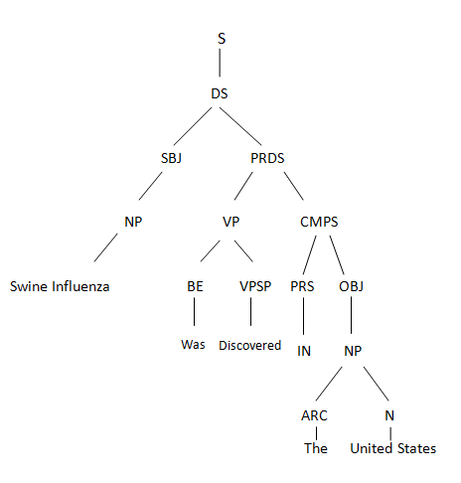
Parsing
the process in which all possible parse trees of a sentence are built.
Notes:
Tree rep. example from net.

Slide 30
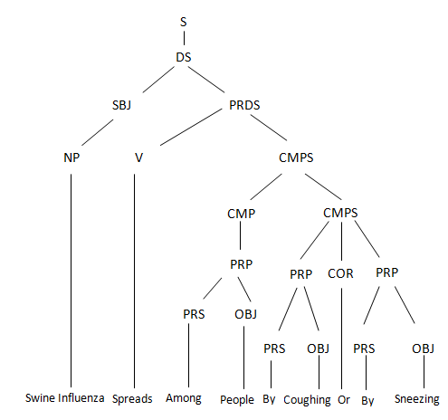
PARSING

Slide 31
Syntax Analysis
the module which produce the final correct parse trees for each sentence in the input text.
Works by :
Assigning weights to each parse tree and the tree with the highest weight will be chosen as the
most perfect tree for the sentence .

Slide 32
Discourse
This task is concerned with assigning each pronoun to the noun which this pronoun refers to.
Example:
Mobile phones have become the most essential means of communication. They have become a part of everyday life for many individuals.

Slide 33
Word Sense Disambiguation
This task is concerned with assigning the most proper sense (meaning) for each word according to the formulation of the sentence.
Using WordNet.

Slide 34
Plain English Text
Frontend
Meaning Representation
Multilevel TMR
Mind Map Conversion
Automatic Layout Allocation
Mind Map

Slide 35
Meaning Representation
What is Meaning Representation?
It’s a data structure
Puts text in a format that best represents its meaning
Enables the computer to understand:
The meaning of the words in a sentence
What the words stand for
The relations between words in a sentence

Slide 36
Meaning Representation Example
Sentence:
This new virus was discovered in people in the United States in April of 2009

Slide 37
USA
New
Location
Adjective
Virus
Discovered
People
Theme
Location
Time
April 2009
Notes:
Meaning representation diagram

Slide 38
Meaning Representation Example
Sentence:
Cleansers for hands can be used when soap and water are unavailable

Slide 39
Hands
Purpose
Cleansers
Unavailable
Theme
Adjective
Used
Condition
Soap
Condition
Water
Unavailable
Adj
Notes:
Condition: Domain Relation

Slide 40
Meaning Representation Reconstruction
Why the reconstruction?
Parser rules have been modified to accept a wider range and complex forms of English sentences. So….
The parse trees generated changed.
The TMR was reconstructed to adapt to these changes and accept these complex forms.
Notes:
Ahh ya3ni, >>>hena msh bs ben3mel reconstruction 3ashan el parser rules increased but we must show ahmyet ely 3amalnah we en zama kan veryyy simple but NOW fazeee3.

Slide 41
Demo
Notes:
Enter sentences, showing their mature(er) sturcture and the output
Several
Could do with screen shots

Slide 42
Plain English Text
Frontend
Meaning Representation
Multilevel TMR
Mind Map Conversion
Automatic Layout Allocation
Mind Map

Slide 43
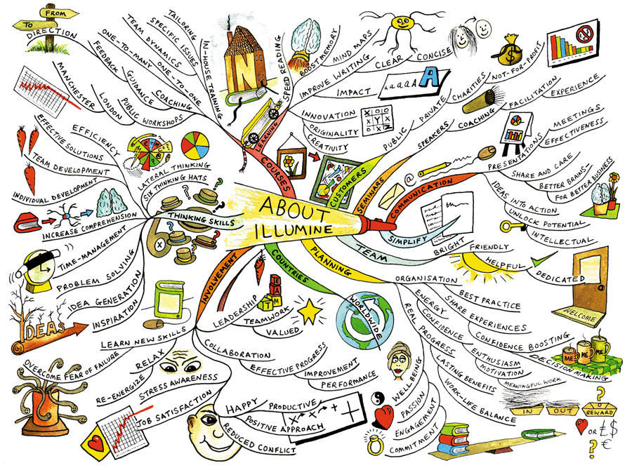
Why Multilevel Mind Mapping?
Totally defying the purpose of…
Comprehension speed
Simplicity
Clarity

Slide 44
What we want to achieve..
What we want to achieve…
G
A
B
C
D
E
F
G

Slide 45
Phases of Multilevel Generation
Text Meaning Representation
Weight Assignment
Weight-Based Partitioning
Concept-Based Partitioning
New Text Meaning Representation

Slide 46
Weight Assignment
We assign weights to each node.
The most important, relevant nouns and verbs rank the highest.
Why do so?
For the decision making of which to keep, which to eliminate, and which to move on to another level.

Slide 47
Weight Assignment (Cont’d)
How we’ll do it…
Using case role relations we rank the more relevant nouns higher than the others.
Using the nouns and their rankings we rank the verbs.

Slide 48
Weight-Based Partitioning
We group the nouns according to their weights.
We cluster their weights using K-Means++.
The nouns corresponding to the cluster with the highest centroid are marked as the main noun frames.

Slide 49
Concept-Based Partitioning
The actions of each main noun frame are grouped according to an ontology.
An ontology is a formal representation of a set of concepts within a domain.
The semantically related actions are grouped.

Slide 50
Concept-Based Partitioning (Cont’d)
DRUG – PILL – TREAT – HEADACHE – CURE - COUGH – HEAL – SNEEZE
MEDICAL-EVENT {TREAT – CURE – HEAL}
MEDICAL-ARTIFACT {DRUG – PILL}
ANIMAL-SYMPTOM {HEADACHE – COUGH – SNEEZE}

Slide 51
Demo

Slide 52
Plain English Text
Frontend
Meaning Representation
Multilevel TMR
Mind Map Conversion
Automatic Layout Allocation
Mind Map
Notes:
Zabbat animation

Slide 53
Mind Map conversion
This phase converts the obtained multileveled text meaning representation into an automatically laid out mind map that contains images.
Images are an excellent memory aid. they tend to be more memorable to your brain than words do.

Slide 54
Plain English Text
Frontend
Meaning Representation
Multilevel TMR
Mind Map Conversion
Automatic Layout Allocation
Mind Map

Slide 55
Automatic Layout Allocation
Simulated Annealing Algorithm
Substance is heated until it is liquid.
Then slowly cooled until it is solid.
Slow cooling allows molecules to organize themselves into a crystal.

Slide 56
Automatic Layout Allocation (Cont’d)
Spring Model Algorithm
Replaces edges with springs.
Springs attract their endpoints when stretched
Springs repel their endpoints when compressed.
The vertices are initially placed randomly .
Differential equations are solved to find the system state with minimum energy.

Slide 57
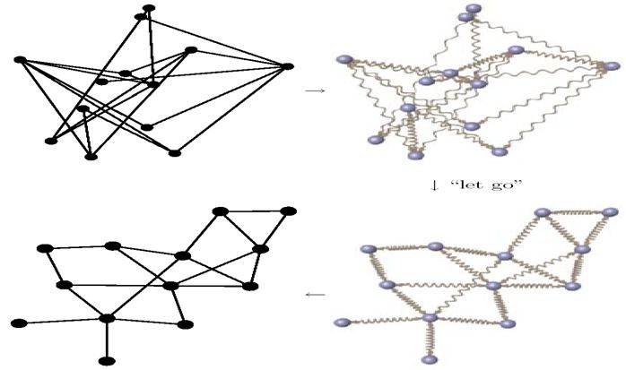
Spring Model

Slide 58
Demo

Slide 59

Conclusion (cont’d)
Mind Map Generator is the first tool to automatically generate mind maps from plain English text.
It is able to process larger, more complex English than it previously did.

Slide 60
Conclusion (cont’d)
The input still has one restriction; it has to be written in formal English.
The output
A multileveled mind map
The mind map automatically laid out on the screen.

Slide 61

Future Work
Developing an Arabic version of the MMG.
Building text meaning representation without a parser

Slide 62

Tools
Visual Studio 2008
WordNet 2.0
Protégé

Slide 63

References
Mind Map Generator, Ain Shams University, Faculty of Computer & Information Sciences, Computer Science Department, supervised by Prof. Dr. Mustafa Aref and Dr. Mohamed Abdeen
K-Means++: The Advantages of Careful Seeding, David Arthur,
Stanford University, Supported in part by NDSEG Fellowship,
NSF Grant ITR-0331640, and grants from Media-X and
SNRC.
Sergei Vassilvitskii, Stanford University, Supported in part by NSF Grant ITR-0331640, and grants from Media-X and SNRC.
Automatic Graph Drawing Algorithms, Susan Sim, simsuz@turing.utoronto.ca
December 17, 1996.
Notes:
And some more

Slide 64
References
MIKROKOSMOS http://crl.nmsu.edu/Research/Projects/mikro/index.html
http://www.mapyourmind.com/advantages.html
http://www.peterrussell.com/MindMaps/Advantages.php
http://www.peterrussell.com/MindMaps/Uses.php
http://www.mind-mapping.org/mindmapping-and-you/basic-introduction-to-mindmapping.html
Notes:
And some more

Slide 65
Thank You!

